Slide 1
Testing and teaching English intonation to Chinese students
Prof. Irina Pavlovskaya
IATEFL-50, TEA SIG, Birmingham, 2016

Slide 2
Evolution of terms
Bilingualism, Poliglotism (Scherba, Veinreich)
Multilingualism, Plurilingualism (CEFR)
Translingualism, Perfomative competence
(Canagarajah, 2013)
Intecultural communicative competence
(Camerer, Marder, 2014)
Common phonological competence
(Pavlovskaya, 2014)
Common suprasegmental (intonational) competence

Slide 3
Multilingualism : “…the plurilingual approach emphasises the fact that as an individual person’s experience of language in its cultural contexts expands, from the language of the home to that of society at large and then to the languages of other peoples (whether learnt at school or college, or by direct experience), he or she does not keep these languages and cultures in strictly separated mental compartments, but rather builds up a communicative competence to which all knowledge and experience of language contributes and in which languages interrelate and interact.
“Common European Framework of Reference for Languages: learning, teaching, assessment”

Slide 4
We need to consider how people engage with each other, tailor their language uses reciprocally, display uptake, resist dominant conventions, and co-construct meanings in relation to existing norms and ideologies in actual interactions
S. Canagarajah
Translingual Practice: Global Englishes and Cosmopolitan Relations. Routledge, 2013, p.28

Slide 5
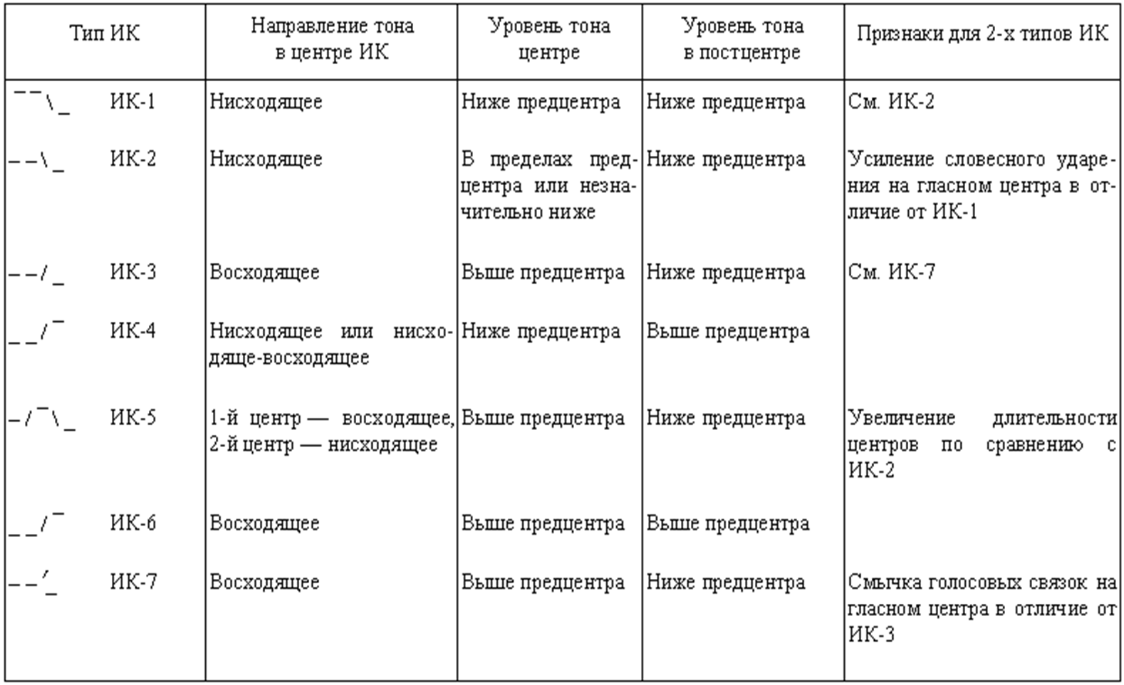
Intonational Constructions of the Russian Language
(by E.A. Brizgunova)

Slide 6
Learn intonation in russian general questions Part 3 - YouTube
RUSSIAN INTONATION: ik-2

Slide 7
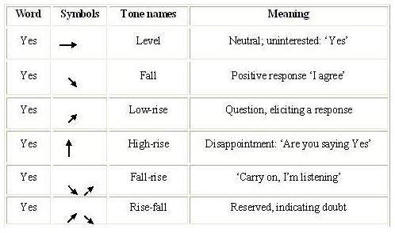
English nuclear tones

Slide 8
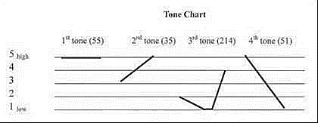
Chinese Tones (by N.A. Speshnev)

Slide 9
I have labeled the cross-language and cross-species use of acoustic frequency – whether in the sound source or the sound resonances -- to convey impressions of size (and related concepts) the “frequency code”.
John J. Ohala . Sound Symbolism.
University of California, Berkeley, P.3

Slide 10
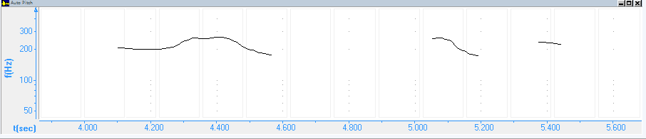

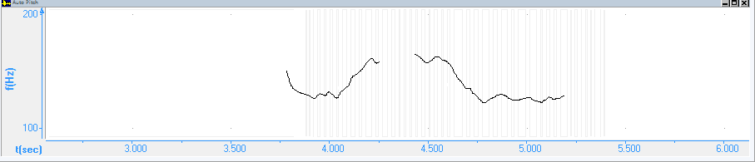
Wǒ yě bú què dìng. (Tone 1) (I’m not sure).
Fo : from 210 Hz to 200 Hz in 100 msec.
You ‘might be right.(Mid level)
Fo: from 180 Hz to 185 Hz in 400 msec.

Slide 11
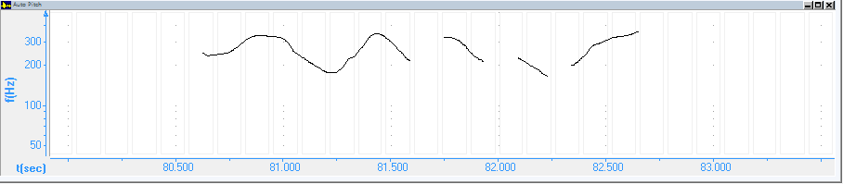
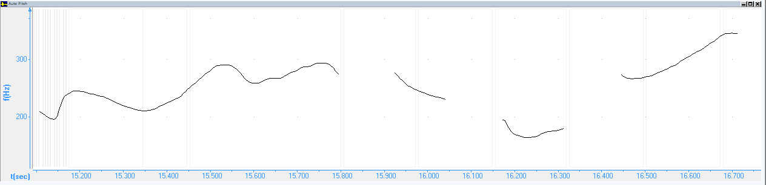
‘Nǐ yǒurì jì ‘běnme?(Tone 2)
Fо: from 200 Hz to 350 Hz in 450 msec.
‘Do you’ want some coffee?(Low rise)
Fо: from 200 Hz to 350 Hz in 500 msec.

Slide 12
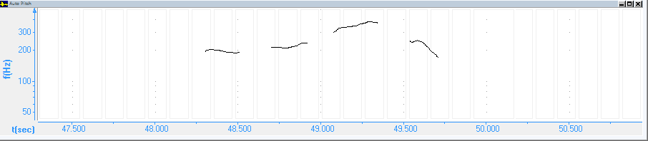
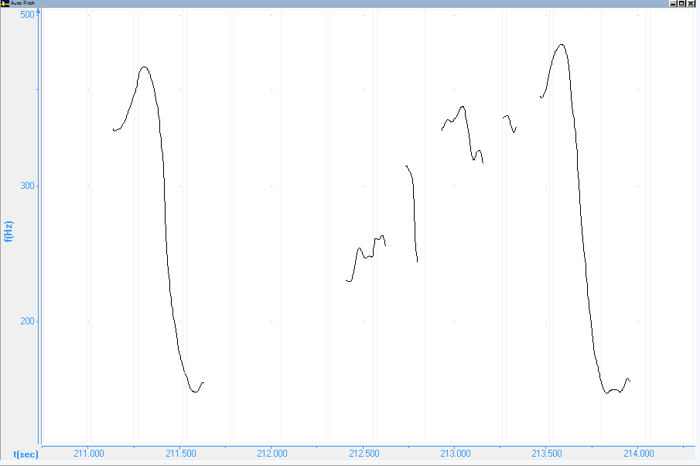
Bǎochí ‘ānjìng! (Tone 4)
Fo: from 350 Hz to 200 Hz in 400 msec.
Hi! ‘What a surprise to see you! (High Fall)
Fo: from 460Hz to 140 Hz in 200 msec.

Slide 14
Identification of English tines by Chinese students | Tone 1 | Tone 2 | Tone 3 | Tone 4
Kitty doesn’t know Spanish.(Low Fall) |  |  |  | 10
Tom is a journalist.(Low Fall) |  |  |  | 10
Do you have a pencil?(Low Rise) |  | 10
What can I do for you?(Low Fall) |  |  |  | 10
Do the task by yourself!(High Fall) |  |  |  | 10
How beautiful the flowers are!(High Fall) |  |  |  | 10
I like fishing. (High Fall) | 1 |  |  | 9
I can’t eat anything.(Rise Fall) |  |  |  | 10
What a gorgeous car!(Low Fall) |  |  |  | 10
Is he a student?(High Rise) |  | 10
What? ‘You lost ‘my money?(High Rise) |  | 10
Mrs. Smith, this is Annie, my niece(High Fall). |  |  |  | 10
Call him right now!(High Fall) |  |  |  | 10
How is your life?(High Fall) |  |  |  | 10
What’s the time now?(High Fall) |  |  |  | 10
Turn down the radio!(Low Fall) |  |  |  | 10
Hi! What a surprise to see you!(High Fall) |  |  |  | 10
She’s nice.(Rise Fall) |  |  |  | 10

Slide 15
English utterances: | Communicative type (Statement, General Question, Special Question, Imparative, Exclamation, Ironical statement)
I’m not sure. (High Fall) | Statement 5
Do you want some offee?(Low Rise) | Special question 2 | General question 3
You ‘might be right.(Mid-Level) | Statement 5
Close the window!(Low Fall) | Imparative 5
Johnnie, come to dinner.(High Fall) | Imparative 1 | Statement 4
Is he a student?(High Rise) | General Question 5
Do you have a pencil?(High Rise) |  |  | General Question 5
You are “so smart”!(Rise Fall) | Ironical Statement 3 |  | Imparative 2
I indeed much admire your “cleverness”.(High Fall) | Ironical statement 3 |  | Statement 2
What is the time now?(High Fall) | Special Question 1 | General Question 4
May I come in?(Low Rise) | General question 5
You know “everything”. (Rise Fall) | Ironical statement 2 | Statement 3
How very beautiful you are!(High Fall) | Exclamation 4 | Statement 1
That could be true.(Mid-Level) | Statement 5

Slide 16
Testing multilingual phonological competence
Step 1
Listen to the utterance. What language is spoken? Is it a question, a statement or an exclamation?
Listen to the utterance. How many stressed syllables do you hear?
What is the total number of syllables in the utterance?
How many words are there in the utterance?

Slide 17
STEP 2
Listen to several words. Which of them are English?
Listen to the word. What language is it spoken in?
Listen to the 3 words. Which is English? Which is Russian and which is Chinese?
Listen to the word. Is it pronounced by a native speaker or not? If it is pronounced incorrectly, say it as it should sound and write it down in phonetic script.

Slide 18
Literature
Cross, J. Understanding and Improving Chinese Learners’ Pronunciation of English. In: ”Speak Out!”- IATEFL PRONSIG Newsletter, May, 2006, Issue 35, p. 16.
Common European Framework of Reference for Language Learning and Teaching. Strasburg: Europarat, 2000.
Gilbert, J. Clear Speech. CUP, 1996.
Pavlovskaya. Teaching Pronunciation in a Multilingual Classroom//RussischeSpracheheute: Zwichen Fremd- und Muttersprache/Das Neue in Erforschung und Vermittlung des Russischen, Buch 3, Hrsg Sergej Afonin und Elena Plaksina. - ISBN 978-3-944209-10-4; ISSN: 2196-3037. – Berlin, 2013.- P. 359-368. Bibliographischen Information in der Deutchen Nationalbibliothech: http://dnb.de)
O’Connor, G, J. Arnold. Intonation of Colloqial English. London, 1973.
O’Connor, G. Better English Pronunciation.CUP,1998
Pavlovskaya I.Yu., Timofeeva E.K. A Beginner’s Course in English Pronunciation.- St. Petersburg: Hipocrates, 2009.- 128 p

